Slide 1

ONLINE VOTING SYSTEM
Submited by: Tanmay Gupta Submitted to: Vikas Khare
Vaibhav Srivastava
Utkarsh Garg
Komal Dixit

Slide 2
TABLE OF CONTENT
S . No | Topic
1. | Introduction
2. | Objective
3. | Future Scope
4. | Data Flow Chart
5. | Admin Flow Chart
6. | User Flow Chart
7. | E R Diagram
8. | Diagram
9. | Screen Shots
10. | Conclusion
11. | Team Members
12. | Reference

Slide 3
INTRODUCTION
“ONLINE VOTING SYSTEM” is an online voting technique. It is based on the other online services like “ONLINE RESERVATION SYSTEM” .In this system people who have citizenship of INDIA and whose age is above 18 years of any gender can give his\her vote online without going to any polling booth.
In “ONLINE VOTING SYSTEM” a voter can use his\her voting right online without any difficulty. He\She has to fill a registration form to register himself\herself. All the entries is checked by the DATABASE which has already all information about the voter. If all the entries are correct then a USER ID and PASSWORD is given to the voter, by using that ID and PASSWORD he\she can use his\her vote. If conditions are wrong then that entry will be discarded.

Slide 4
OBJECTIVE
The most crucial factor for a system like e-VOTE to be successful is to exhibit a Voting Protocol that can prevent opportunities for fraud or for sacrificing the voter's privacy
The Voting Protocol that will be designed and implemented for the e-VOTE system will combine the advantages of existing protocols and techniques, while at the same time it will aim at eliminating most of the identified deficiencies and problems. The related attributes that the eVOTE system will fully support, and against which it will be extensively tested and validated, are listed below. These attributes can be also considered, according to the literature, as a set of criteria for a "good" electronic voting system that can easily enjoy the trust and confidence of the voters and process organizers.

Slide 5
FUTURE SCOPE
A Scope survey suggested more than two thirds of the general election polling stations failed basic access tests. Ms Scott [of Scope] said the country’s voting system “isn’t working for other voters either,” demonstrated by “scores of people queuing outside polling stations” at the recent general election. “Over the last decade there has been next to no improvement in the overall accessibility of polling stations or postal voting “There is a pressing need for clearer accountability over how elections are delivered, to help improve the accessibility of current voting methods, as well as expanding these to include alternative methods. “Unless this happens disabled people will continue to struggle to exercise their right to vote “ In a digital age where people can vote by text for the X-Factor and shop and bank online, our voting system really needs to catch up.” Although Scope’s report highlights a significant problems, the proposed solution – online and text voting – would bring its own major problems. Both have been tested out in the UK in a series of pilots with mixed results. Although the pilot series was often popular with the public, it has also been unpopular with many IT security experts who doubt the security of such voting methods, the systems were often unreliable and they were far more expensive than traditional voting methods. They also did not raise turnout significantly. For a good recent summary of the case against these sorts of new voting methods.

Slide 6
DATA FLOWCHART
A data flow diagram (DFD) is a graphical representation of the "flow" of data through an information system, modeling its process aspects. Often they are a preliminary step used to create an overview of the system which can later be elaborated. DFDs can also be used for the visualization of data processing (structured design).A DFD shows what kind of information will be input to and output from the system, where the data will come from and go to, and where the data will be stored.

Slide 7
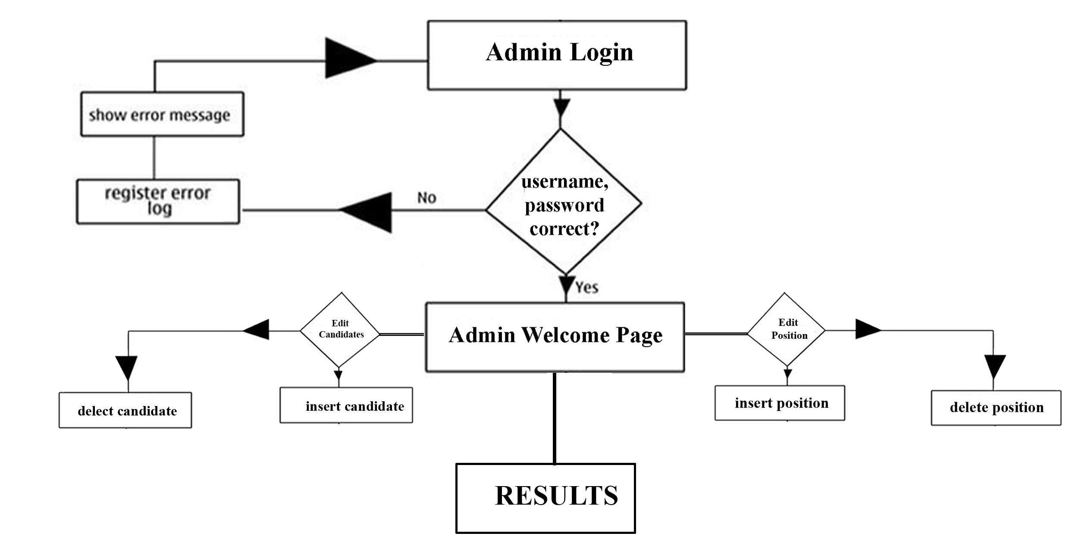
ADMIN FLOWCHART

Slide 8
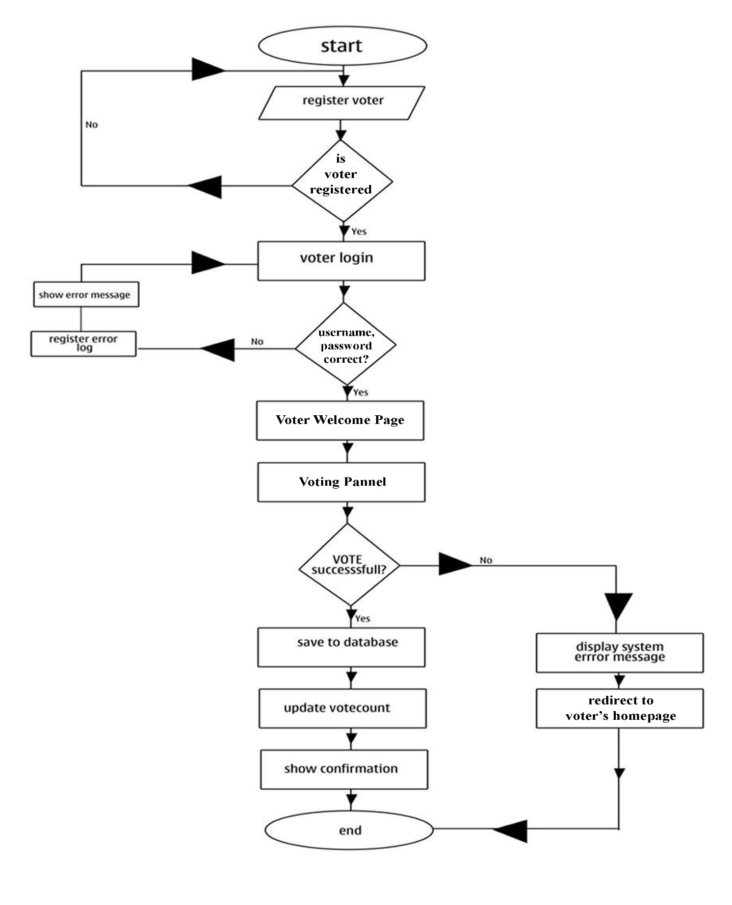
USER FLOWCHART

Slide 9
E R DIAGRAM
In software engineering, an entity–relationship model (ER model) is a data model for describing the data or information aspects of a business domain or its process requirements, in an abstract way that lends itself to ultimately being implemented in a database such as a relational database. The main components of ER models are entities (things) and the relationships that can exist among them.

Slide 10
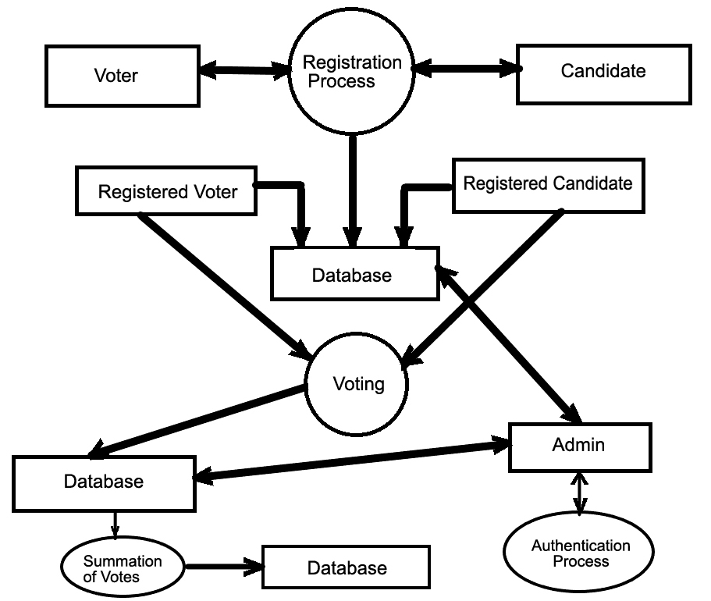
DIAGRAM

Slide 11
SCREENSHOTS

Slide 12
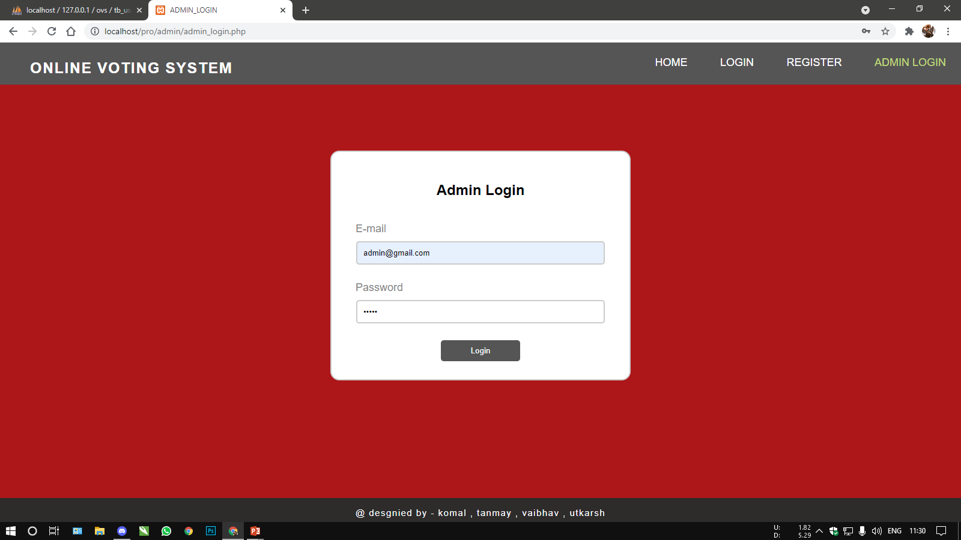
ADMIN LOGIN PAGE
admin

Slide 13
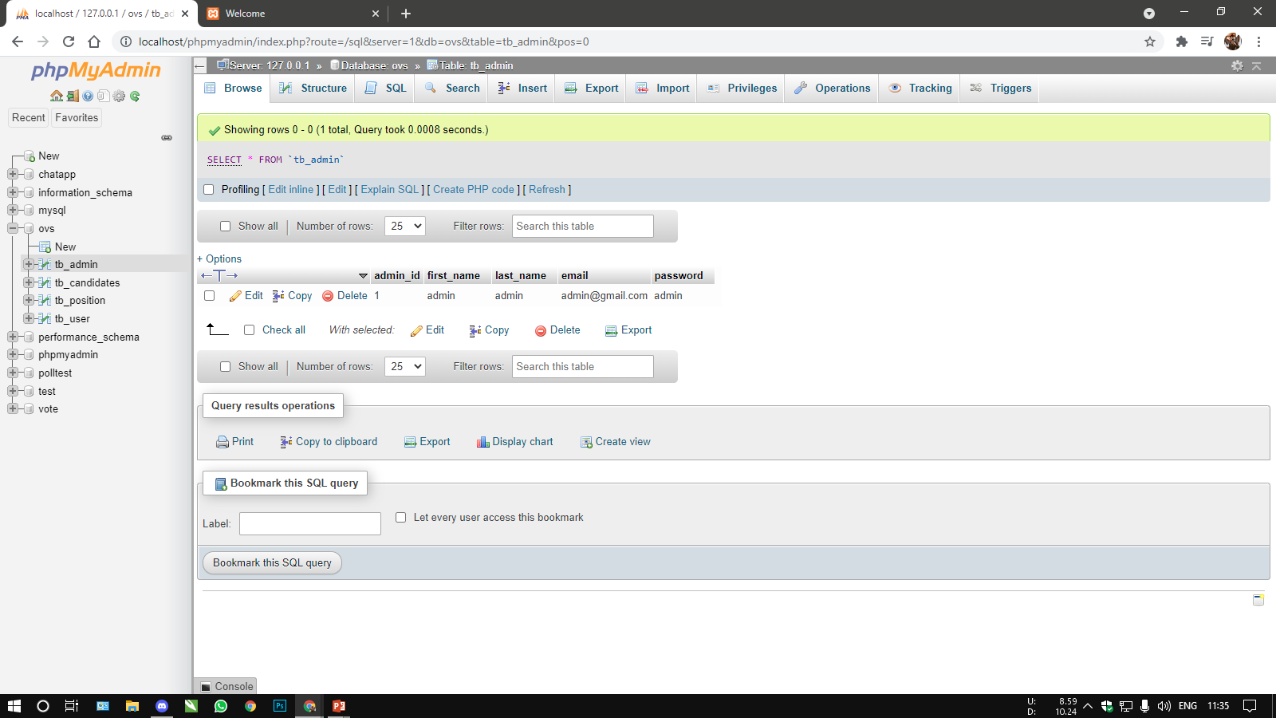

DBMS TABLE OF ADMIN LOGIN PAGE

Slide 14
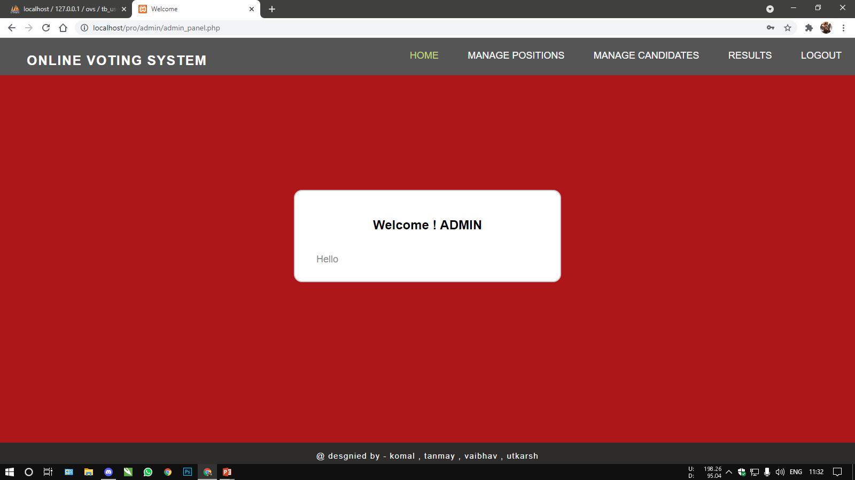
ADMIN WELCOME PAGE

Slide 15
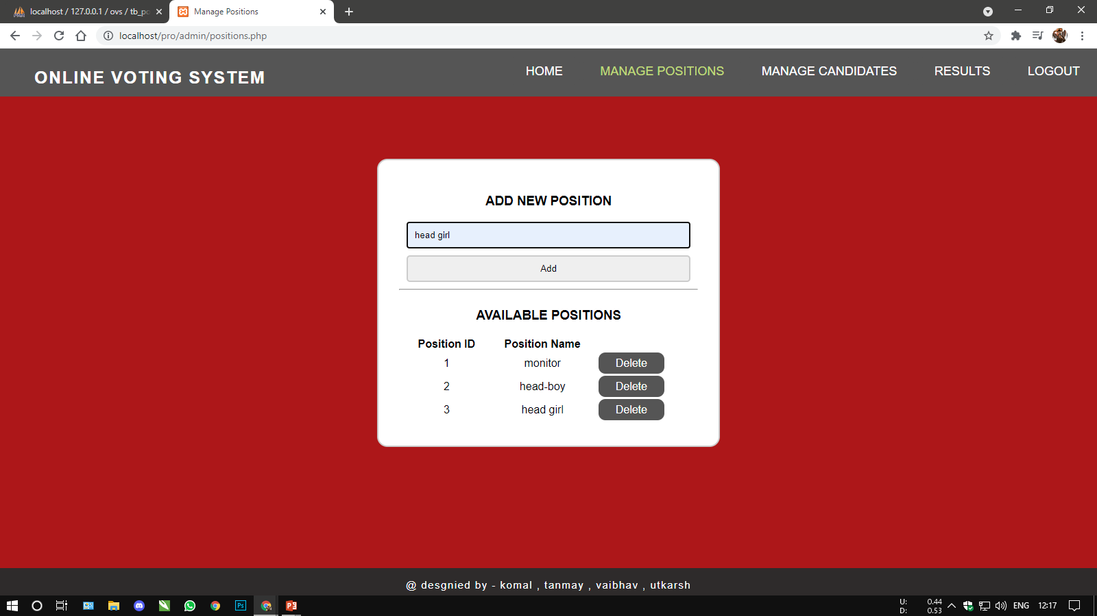
ADMIN – MANAGE POSITION PAGE

Slide 16
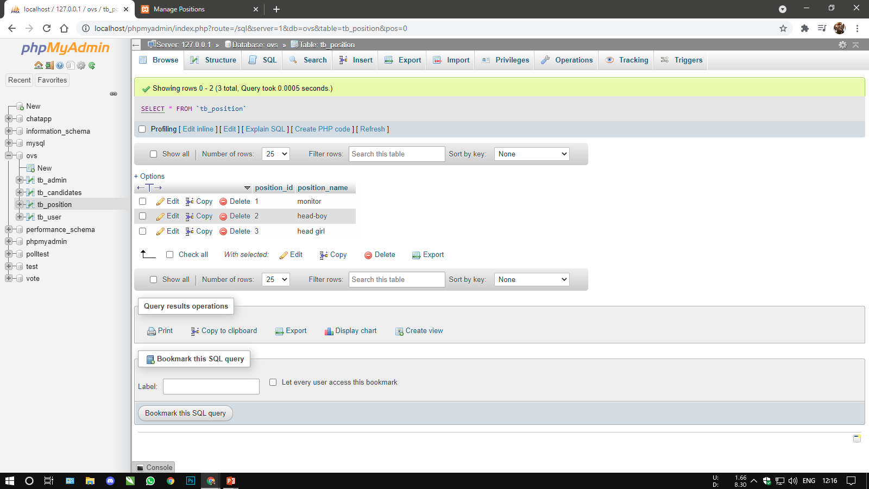

DBMS TABLE OF CANDIDATES POSITION

Slide 17
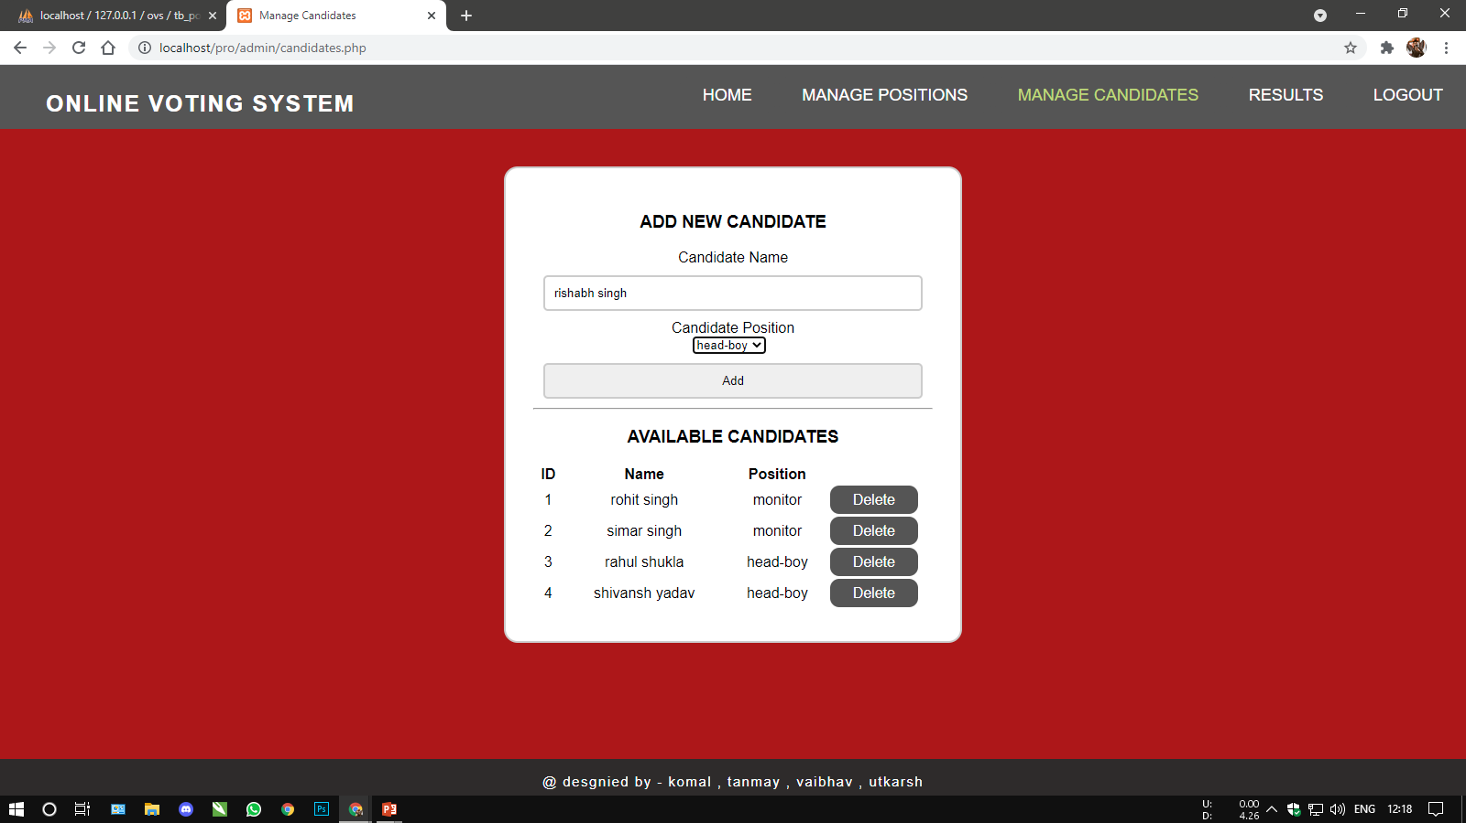
ADMIN – MANAGE CANDIDATES PAGE

Slide 18
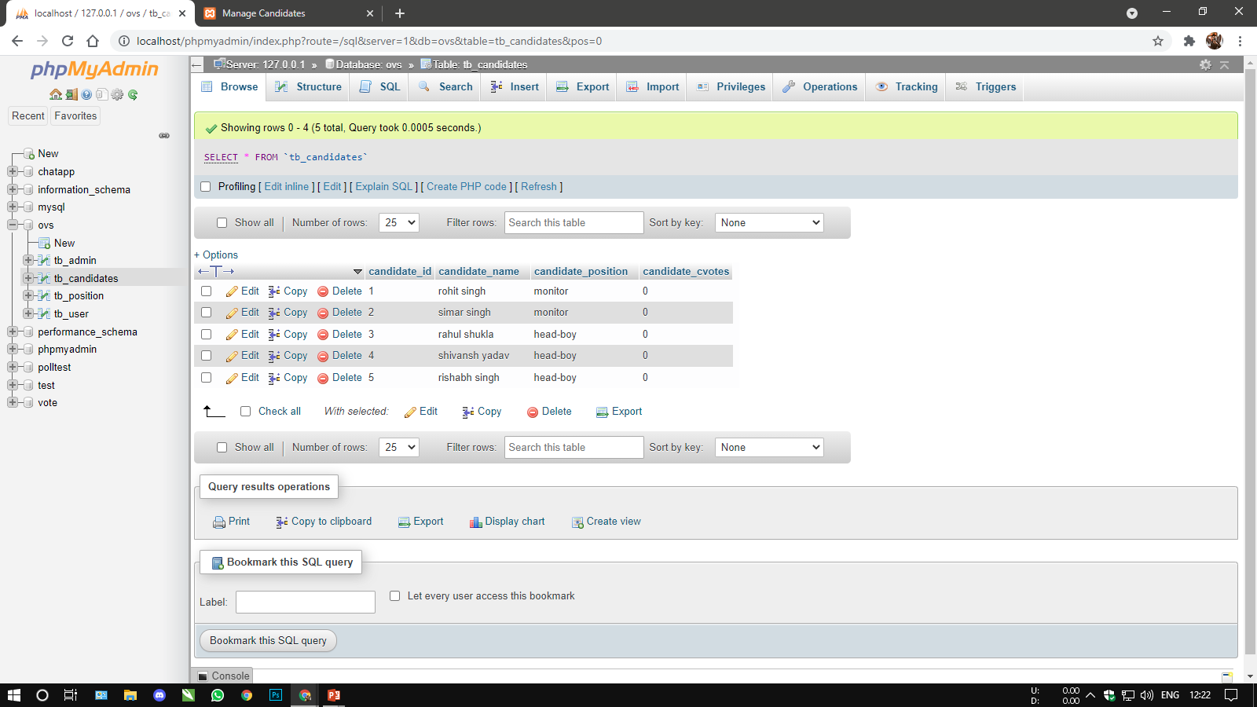

DBMS TABLE OF CANDIDATES POSITION

Slide 19
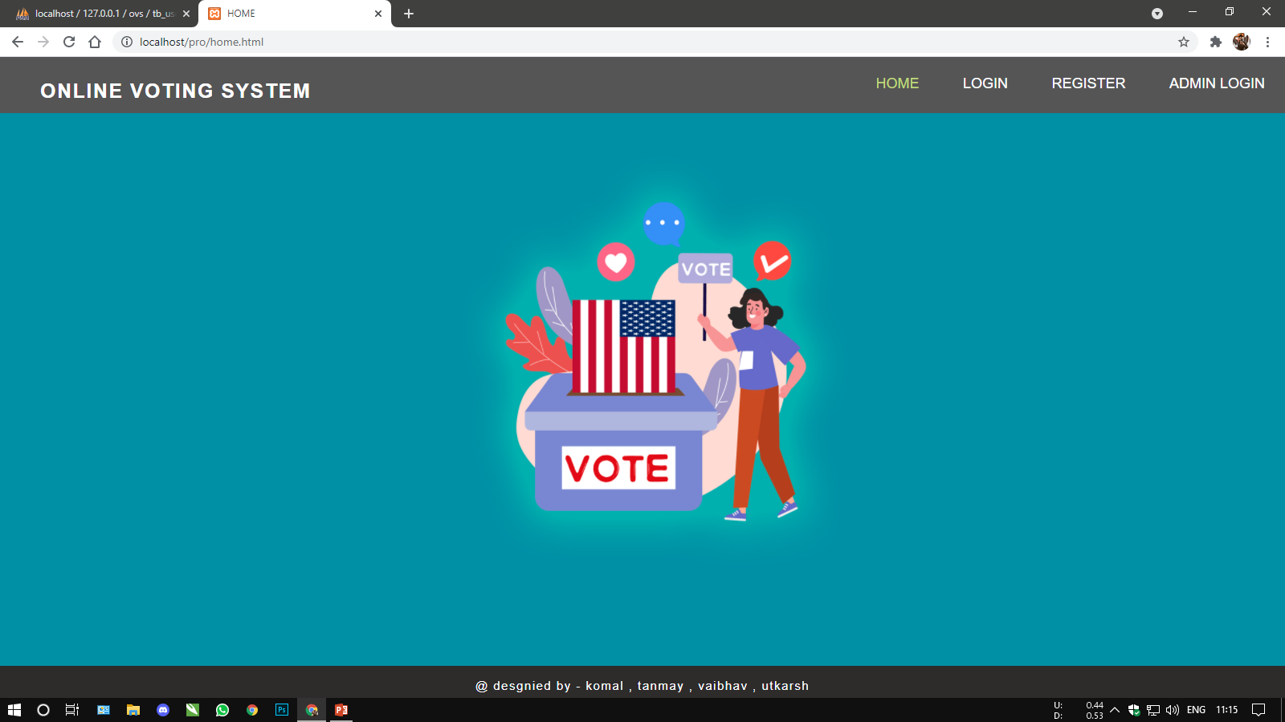
HOME PAGE

Slide 20
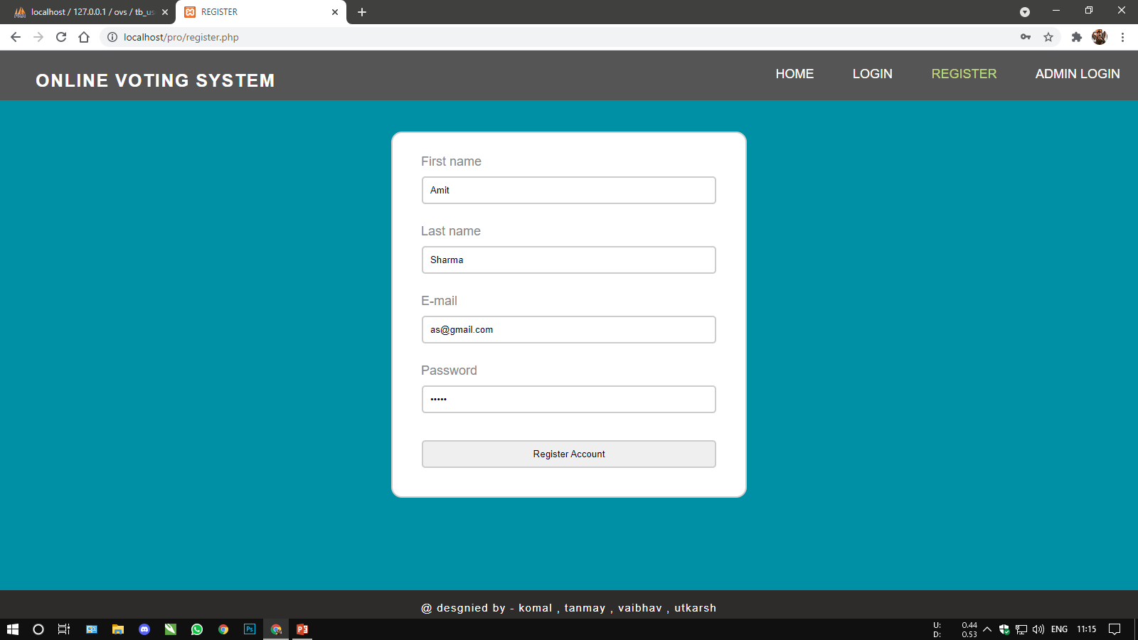
REGISTRATION PAGE
12345

Slide 21


DBMS TABLE OF REGISTRATION PAGE

Slide 22
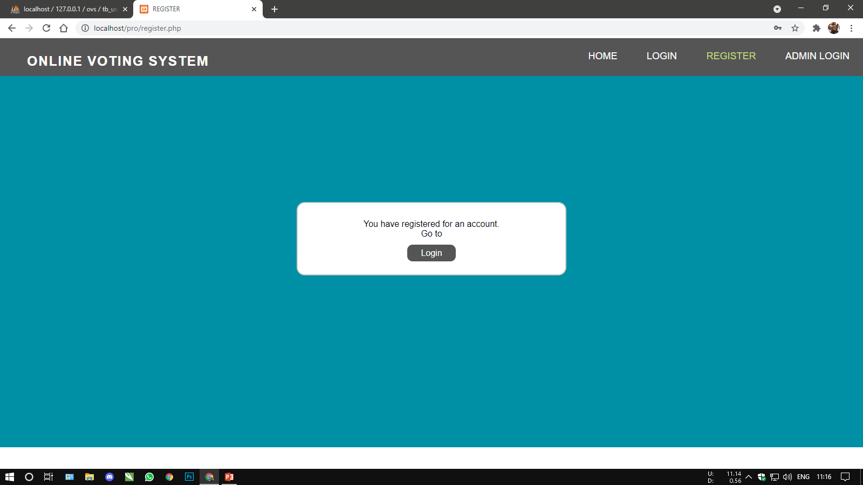
SUCESSFULLY REGISTERED

Slide 23
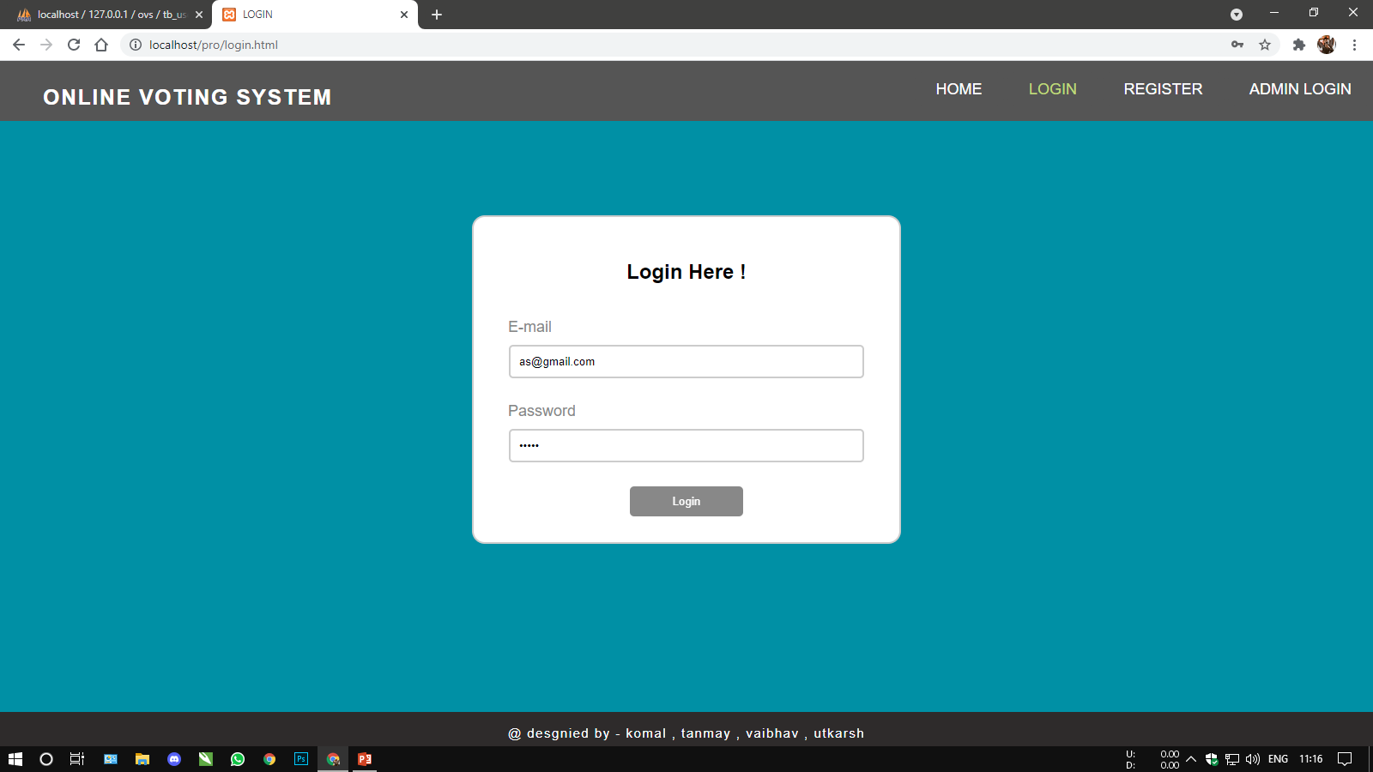
LOGIN PAGE
12345

Slide 24
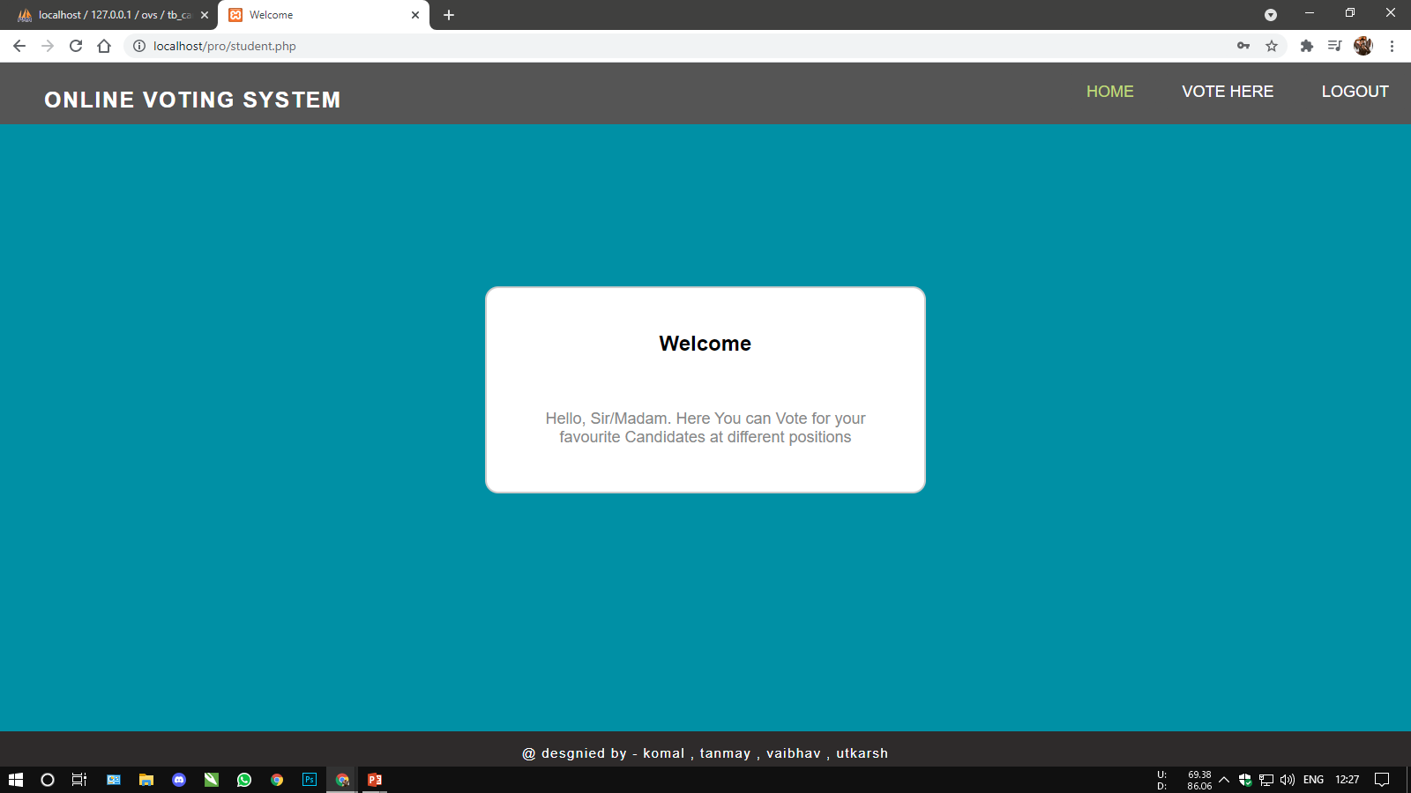
USER WELCOME PAGE

Slide 25
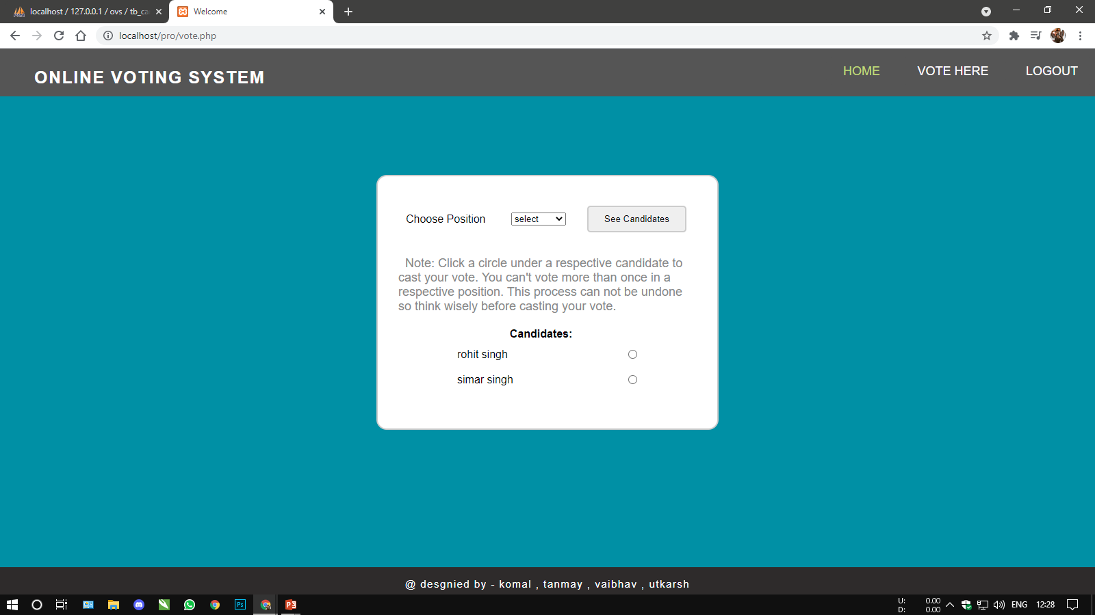
USER VOTING PAGE

Slide 26
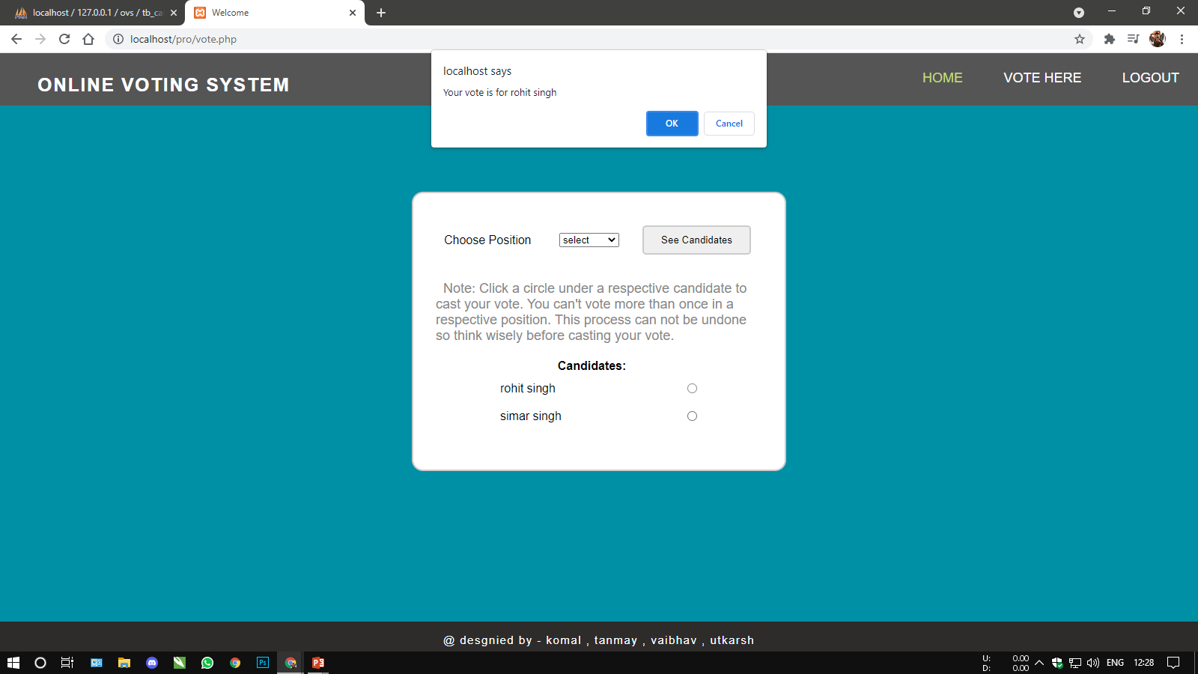
VOTE CONFIRMATION ALERT BOX
.

Slide 27
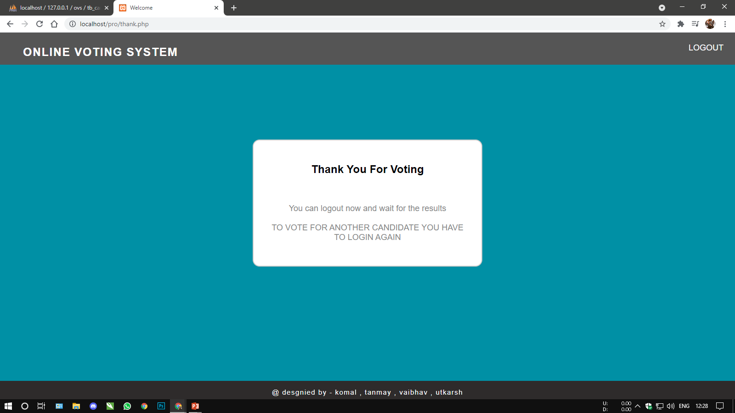
THANK YOU PAGE AGTER SUCCESS VOTING
LOGOUT
HERE

Slide 28
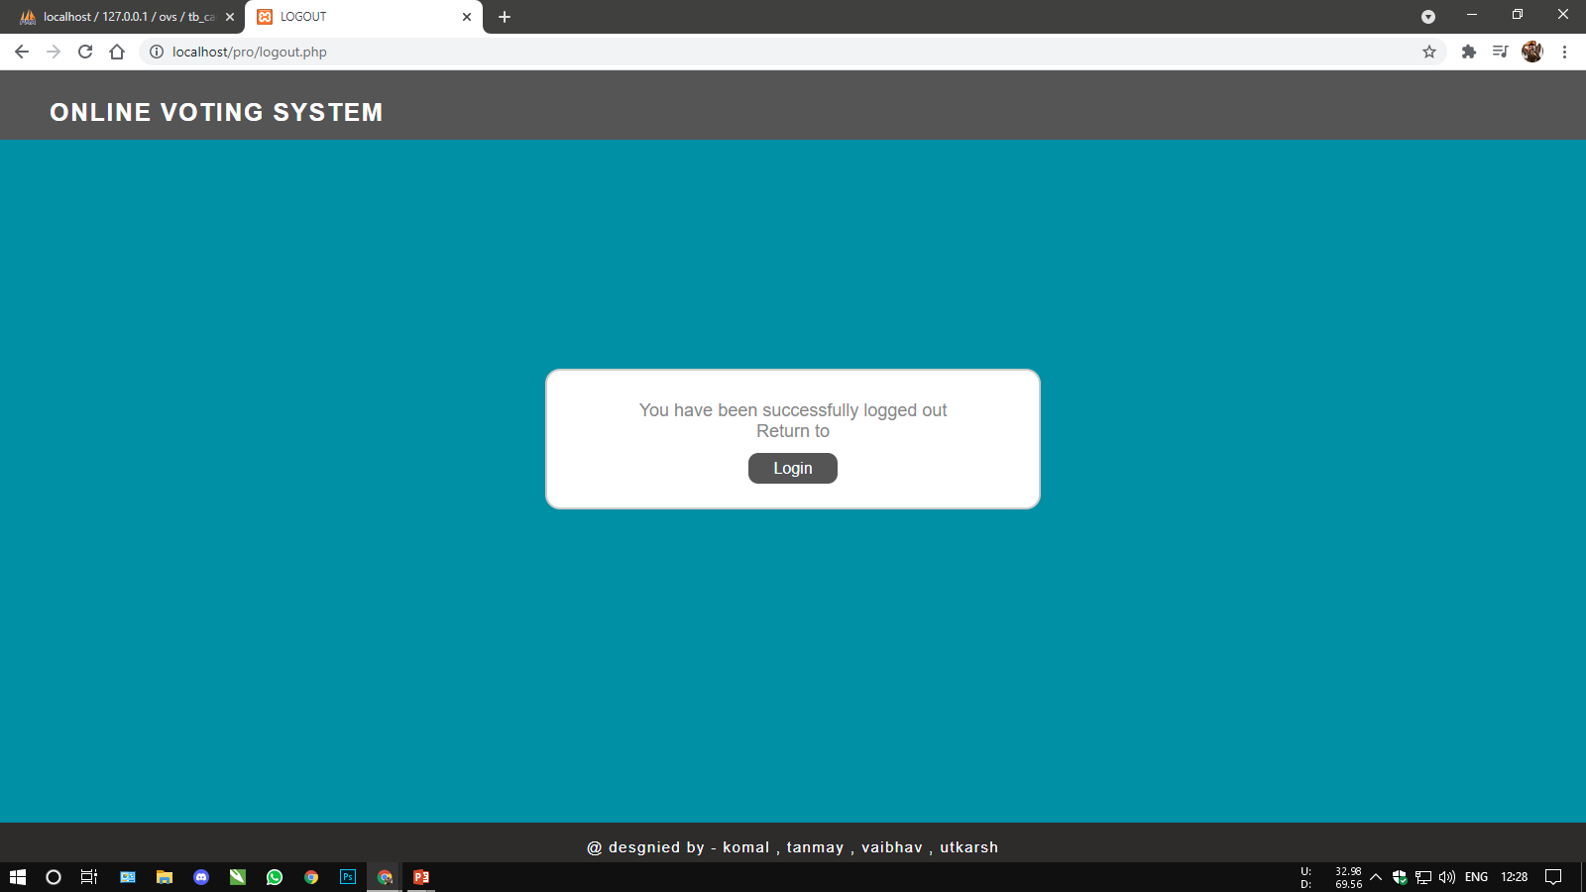
LOGOUT PAGE

Slide 29
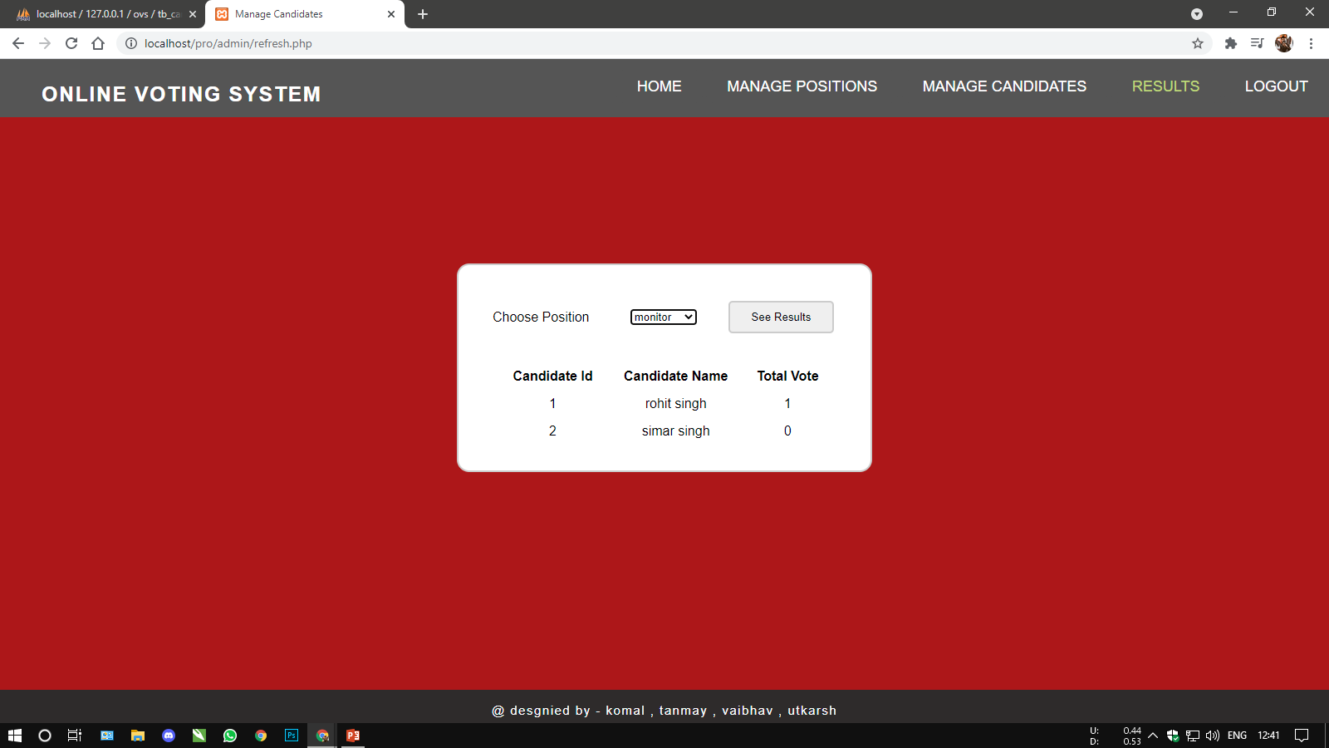
TO CHECK VOTING RESULT
-ONLY ADMIN CAN SEE THE RESULT ON ADMIN LOGIN
NUMBER OF VOTES HERE

Slide 30
CONCLUSION
Generally voting has to be perform by user by going to the voting center. Many users like army person or NRI cannot come to the voting place.
Therefore we have to implement a online voting system by which the users can vote over the online. It is one of the greatest advantage for NRI and person who go outside the country they can vote on online by our software.

Slide 31
TEAM MEMBERS
Tanmay Gupta
Utkarsh Garg
Vaibhav Srivastava
Komal Dixit

Slide 32
REFERENCE
www.google.com
www.wikipedia.com
www.yahoo.com

Slide 33
THANK YOU

